Slide 1
Revision
LANDFORMS AND
LANDSCAPES

Slide 2
How are landscapes different?
Across the Earth, there are many different landscapes, and similarities can be observed within regions.
Variations in landscapes are influenced by factors such as:
Climate
Geographical features- mountains, and rivers
Latitude
Impact of humans
Where landscapes are located

Slide 3
Activity 1: “What LANDSCAPE am I?”
This game is similar to the ‘who am I’ game.
Altogether there are 7 questions.
RULES:
The teacher will write the suggested answers on the board or provide it to students.
Have to wait till the teacher or student finishes reading the clues out loud to the class, before anyone/group can answer.

Slide 4
Suggested answers
GRASSLANDS
COASTAL LANDSCAPES
RAINFORESTS
KARST LANDSCAPES
ISLANDS
MOUNTAINS
DESERTS
BUILT LANDSCAPES

Slide 5
Question 1
I rise above surrounding landscapes
I often have steep sides and high peaks
If I am tall enough, I reach high into the atmosphere where it is cold that snow is found on my peak.
‘WHAT LANDSCAPE AM I?’

Slide 6
Mountains

Slide 7
Question 2
You often find me in regions of low rainfall.
I am found in arid or dry environments.
Where I am, people can experience temperature extremes: hot by day and freezing at night.
‘WHAT LANDSCAPE AM I?’

Slide 8
Deserts
Fun fact: Did you know that Antarctica is the world’s largest desert?

Slide 9
Question 3
I am found in a variety of climates, ranging from hot wet tropics to cooler temperate areas
The lush vegetation are apart of me depends on a high level of rainfall.
Many of our human foods and medicines are derived from me
‘WHAT LANDSCAPE AM I?’

Slide 10
Rainforests

Slide 11
Question 4
Sometimes seen as transitional land found between forests and deserts.
I contain grasses of varying heights and coarseness, and small or widely spaced trees.
I am often inhabited by grazing animals.
‘WHAT LANDSCAPE AM I?’

Slide 12
Grasslands

Slide 13
Question 5
I form when mildly acidic water flows over soluble rocks such as limestone.
Small fractures form, which increase in size overtime and lead to underground drainage systems developing.
Common landforms include limestone pavements, disappearing rivers, reappearing springs, sinkholes and karst mountain
‘WHAT LANDSCAPE AM I?’

Slide 14
Karst landscapes

Slide 15
Question 6
I am areas of land that are completely surrounded by water
I can be either continental or oceanic.
If I am an continental _?_- I lie on a continental shelf, an extension of a continent that is submerged beneath the sea.
If I am a oceanic _?_ - I rise from the ocean floor and are generally in volcanic in origin.
‘WHAT LANDSCAPE AM I?’

Slide 16
Islands

Slide 17
Question 7
I am shaped by natural forces of the wind and waves
These geographical forces erode or construct my natural environment, constantly changing its shape.
Features of my landscape include: beaches, dunes, bays, cliffs, platforms and lagoons.
‘WHAT LANDSCAPE AM I?’

Slide 18
Coastal landscapes

Slide 19
Question 8
I am a landscape that is constructed by humans.
Features of my landscape include: infrastructure such as buildings, roads, transport, energy and telecommunications systems.
I am often a result of damage and destruction of natural landscapes, when I am being constructed.
‘WHAT LANDSCAPE AM I?’

Slide 20
Built landscapes

Slide 21
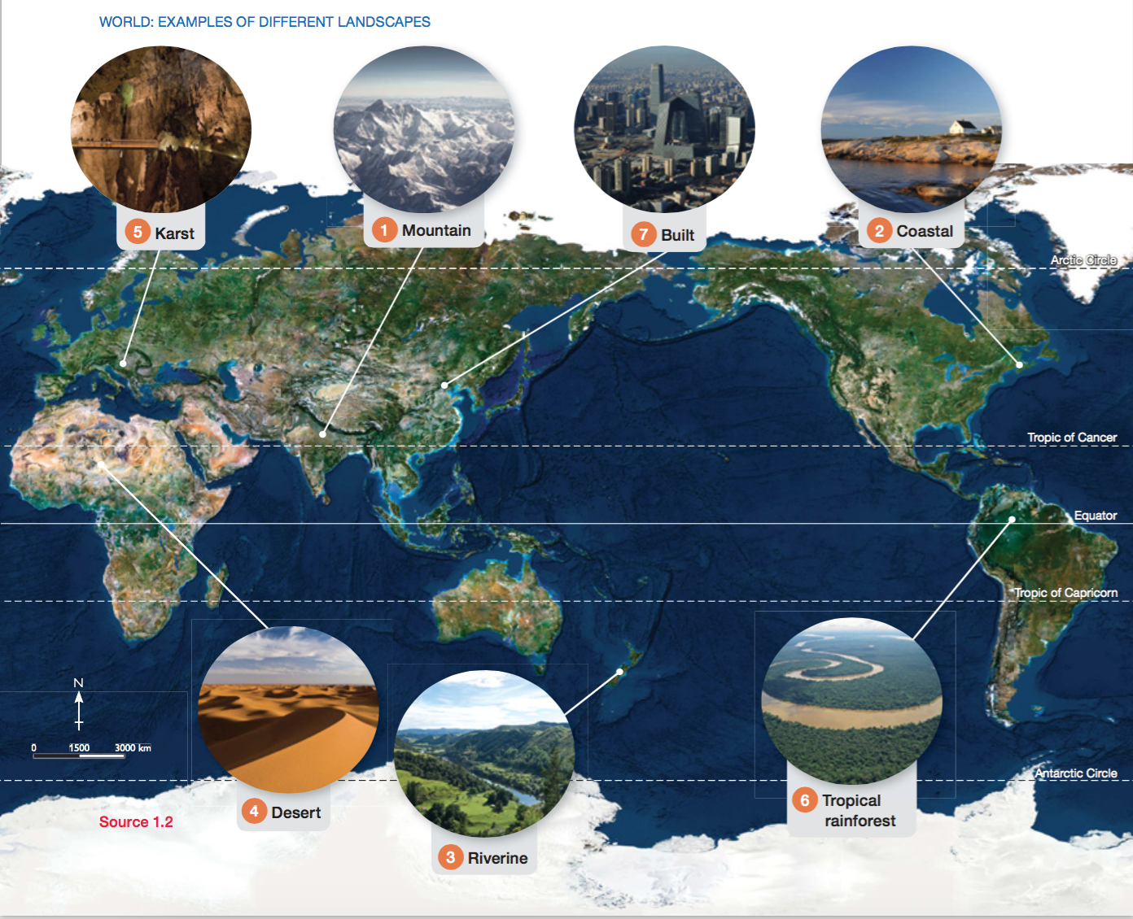

Slide 22

You will need
A pencil
Coloured pencils
Your geography book

Slide 23
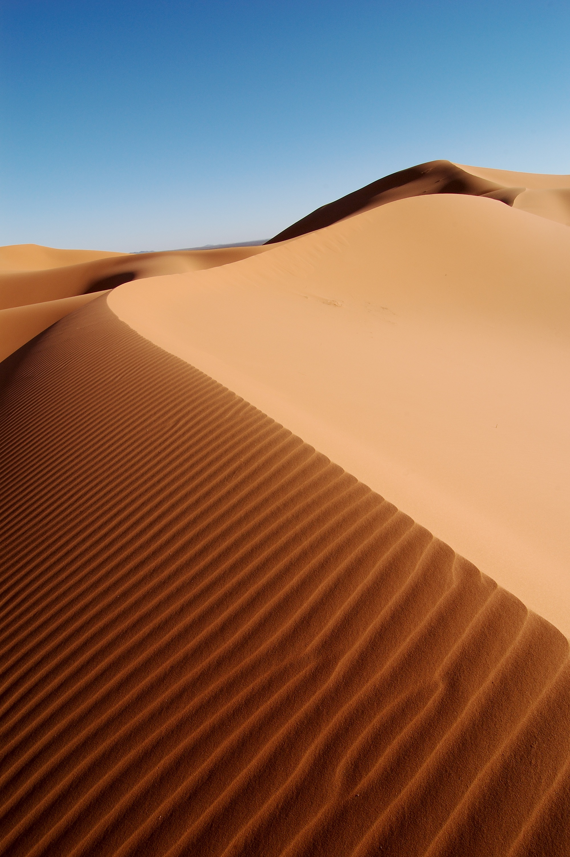
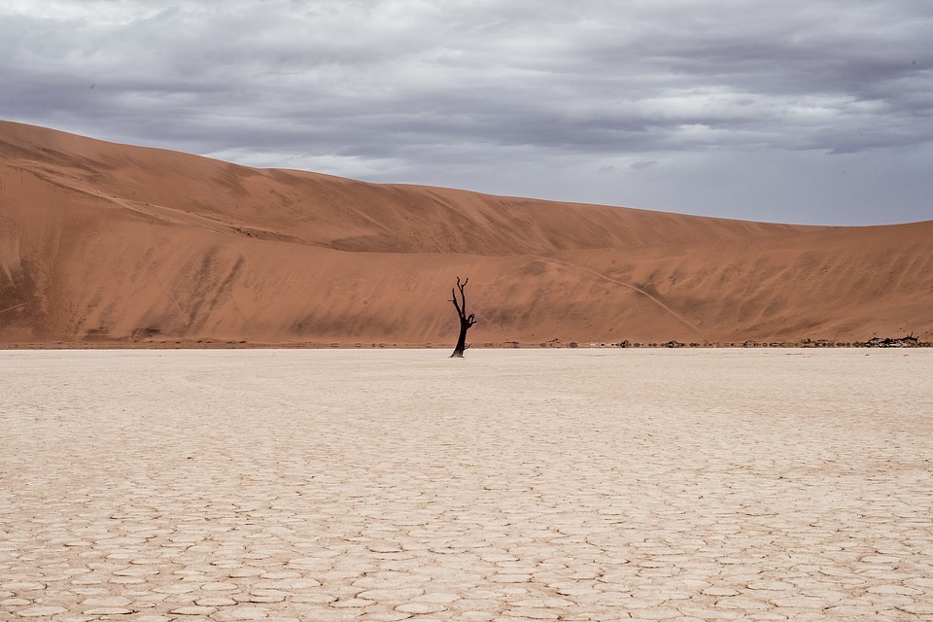
Words of the day
Landform: A natural geographical shape that appears on the earth’s surface. (e.g. dune, hill, valley.)
Landscape: A section of the earth’s surface made up of landforms. It can be natural- e.g. coastal landscape, or built e.g. city landscape.

Slide 24
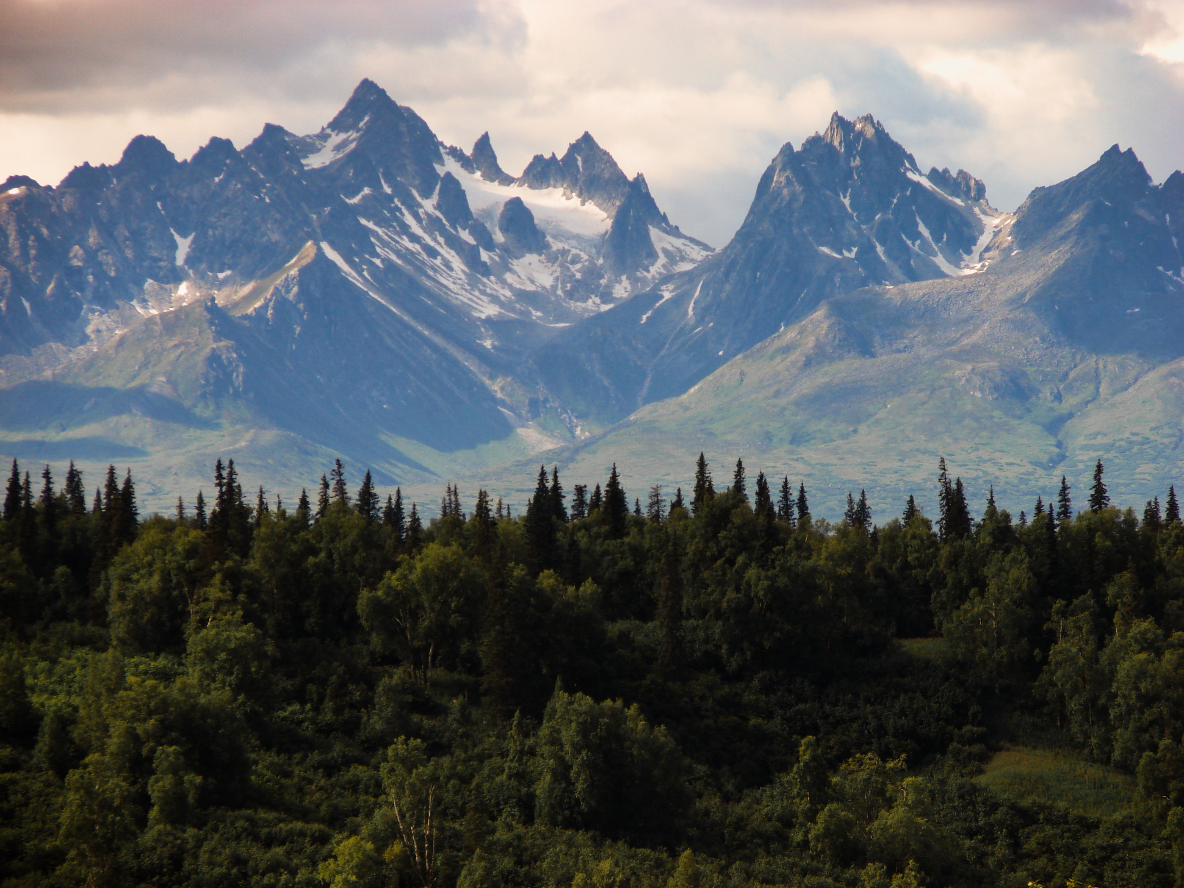
Mountain Landscapes
Mountain landscapes are formed by tectonic plates on the Earth’s surface pushing against each other. This movement and pressure causes the shape of the land to change. Mountains rise high above their surroundings
https://www.youtube.com/watch?v=uy9GFAOGGXU

Slide 25

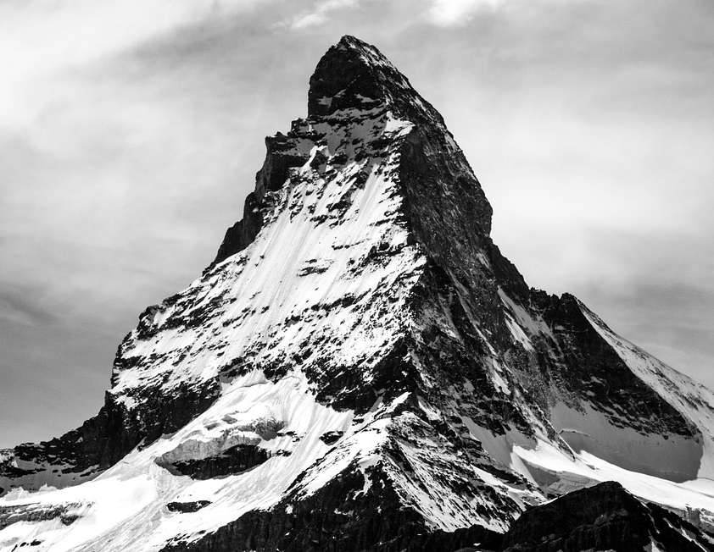
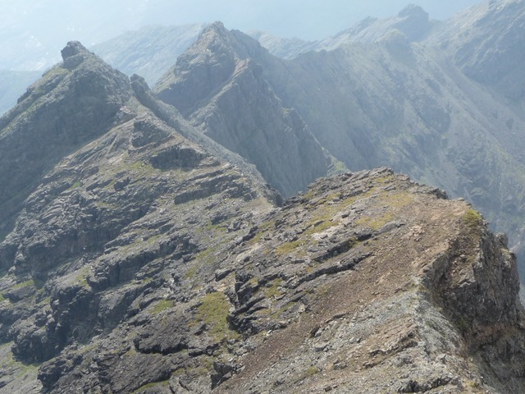
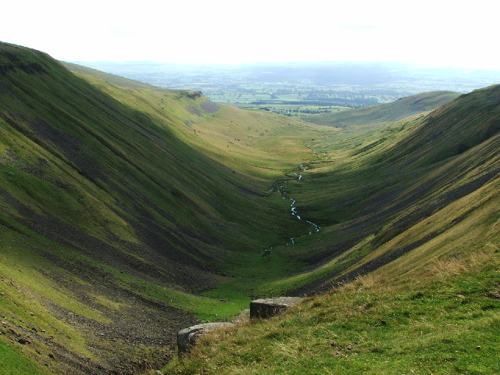
Draw the Landforms
Mountain
Ridge
Valley

Slide 26
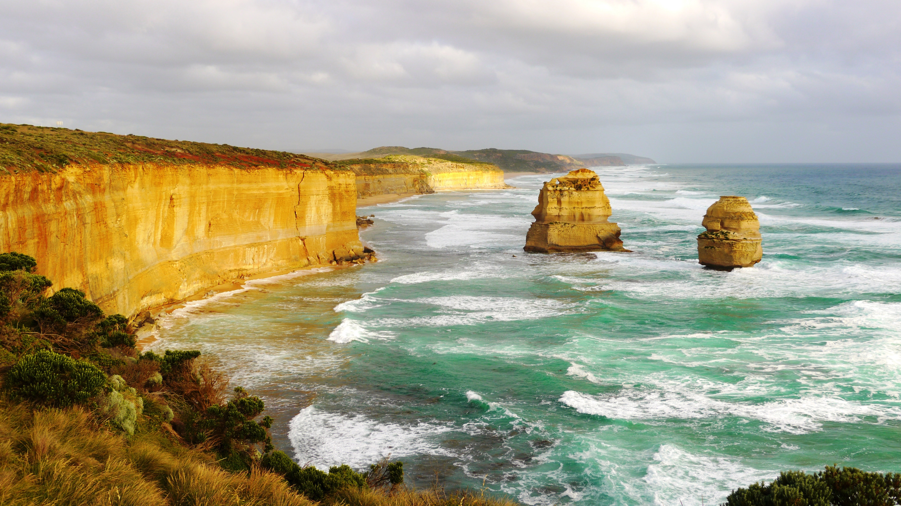
Coastal Landscapes
Coastal landscapes are shaped by the natural forces of the wind and waves.
Features include: beaches, dunes, bays, cliffs, platforms, spits, arches, stacks and lagoons.
https://www.youtube.com/watch?v=4rqrRPVrWJ0

Slide 27
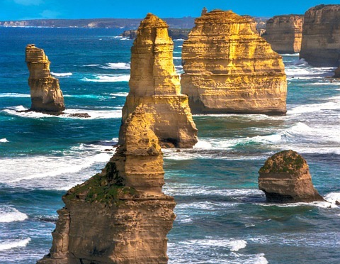
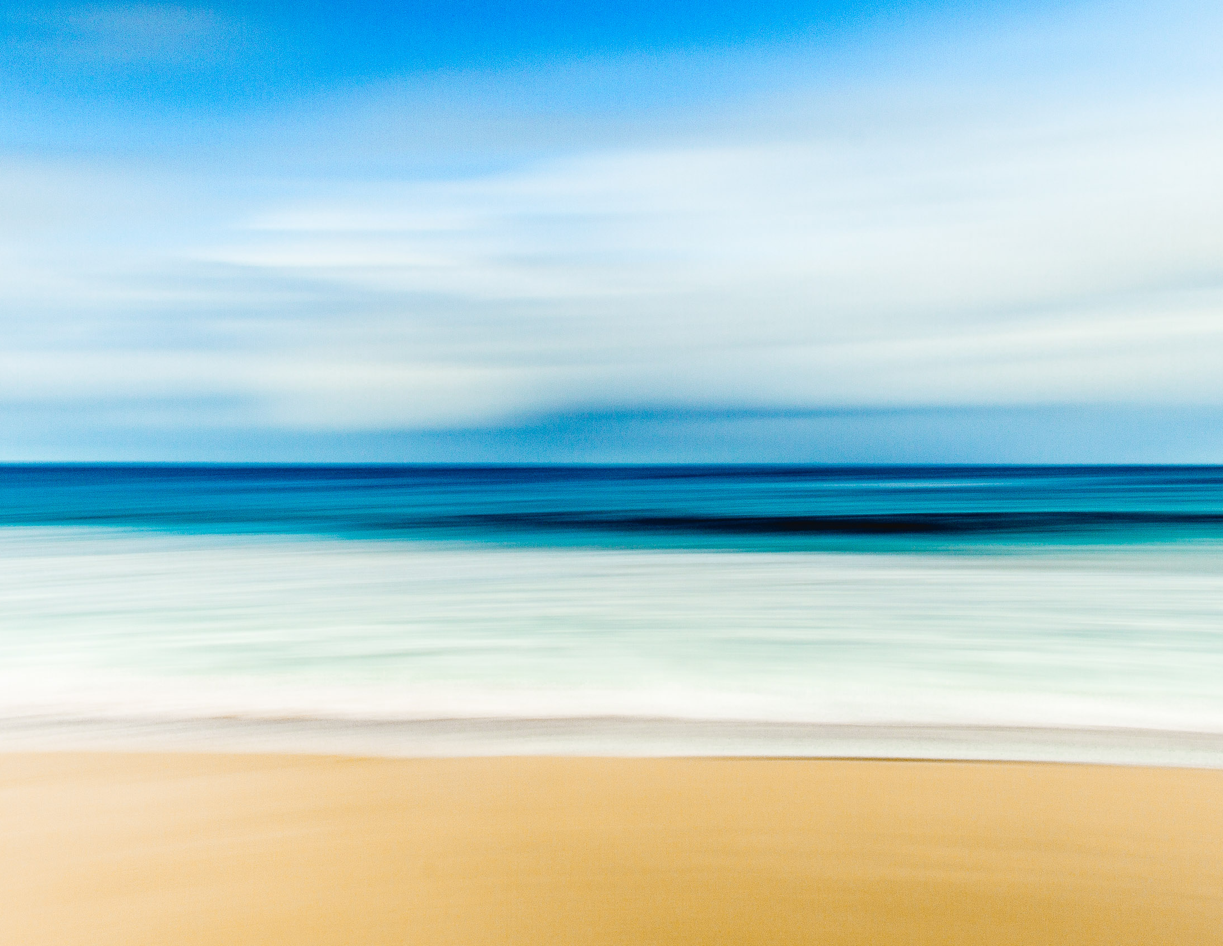
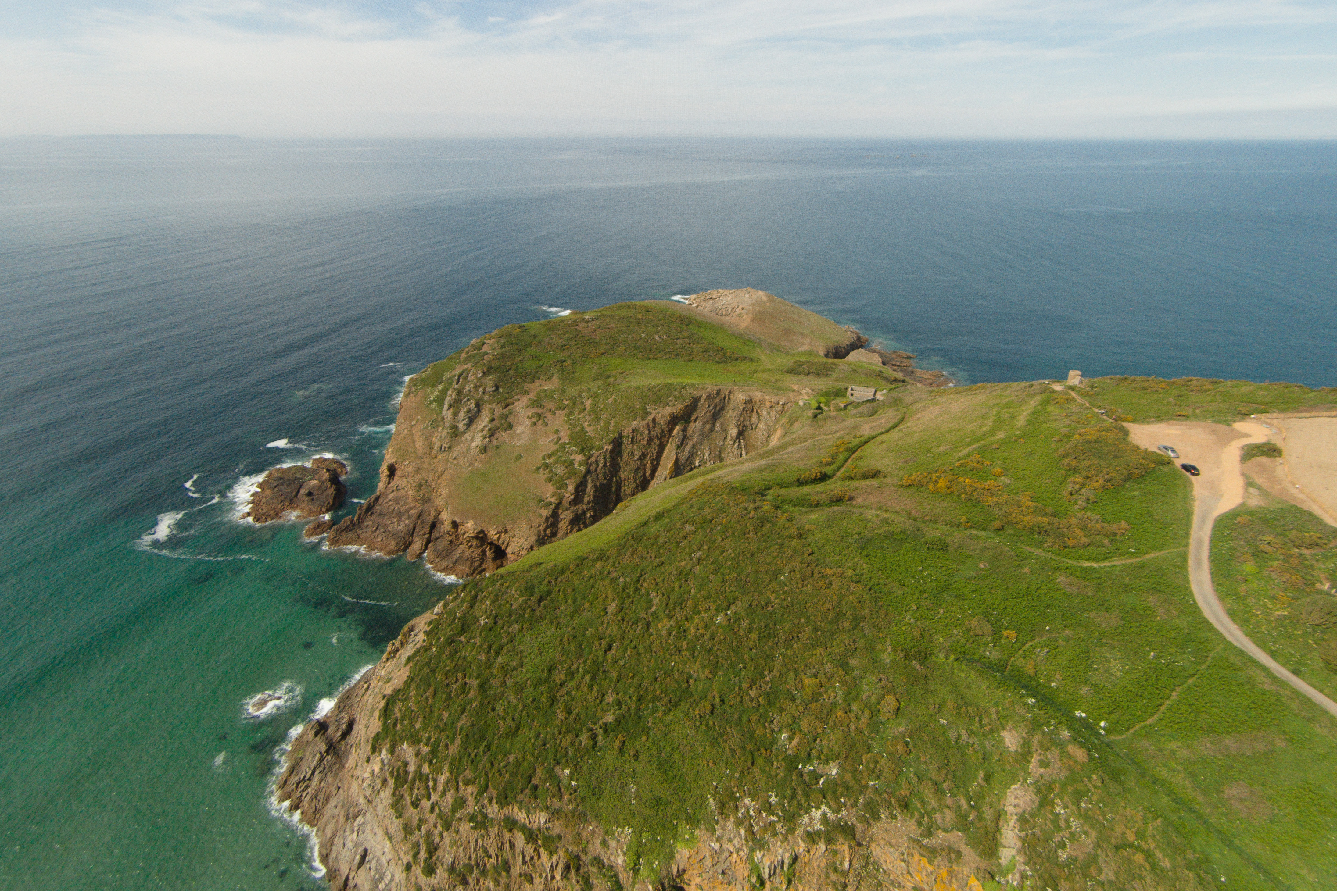
Draw the Landforms
Stack
Beach
Headland
3 minutes
drawing time

Slide 28
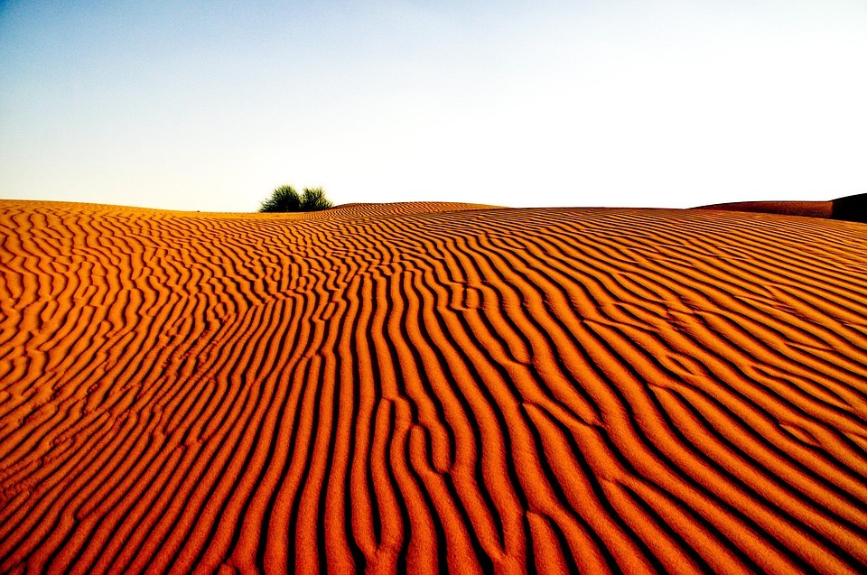
Desert Landscapes
Defined as an area of land which receives no more than 25 millimetres of rain per year. There are two types of deserts – hot deserts and cold deserts.
Common landforms include dunes, plains, oasis, rock hills
https://www.youtube.com/watch?v=n4crvs-KTBw
Notes:
https://www.youtube.com/watch?v=hEC0VVdrE6E extra link with video from PAGE, AZ.

Slide 29
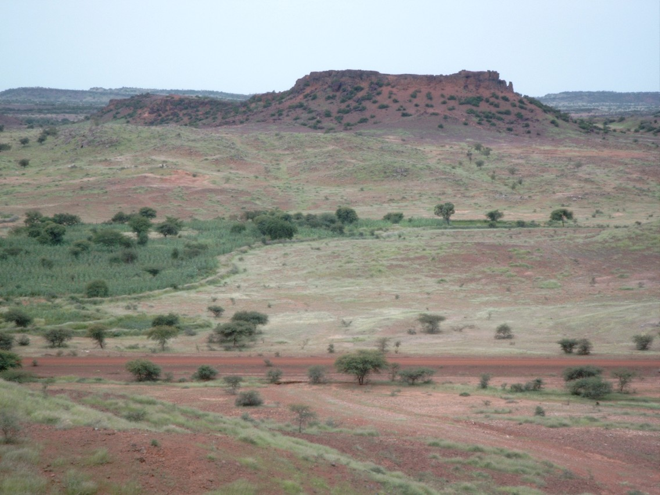
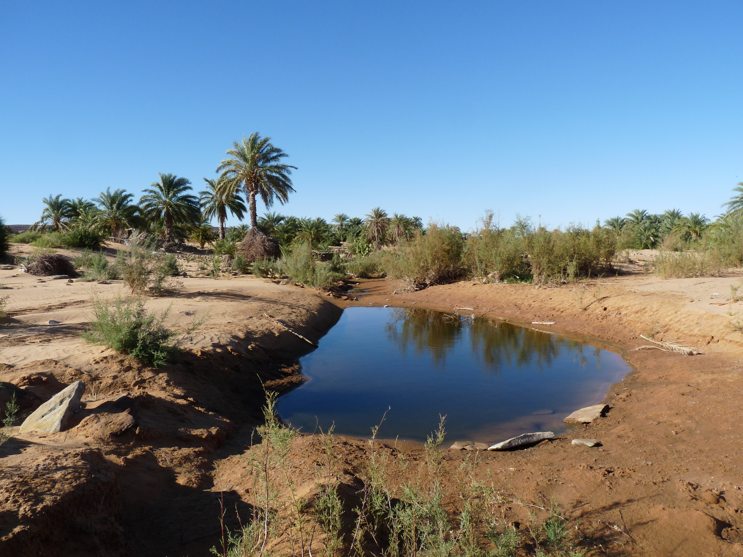
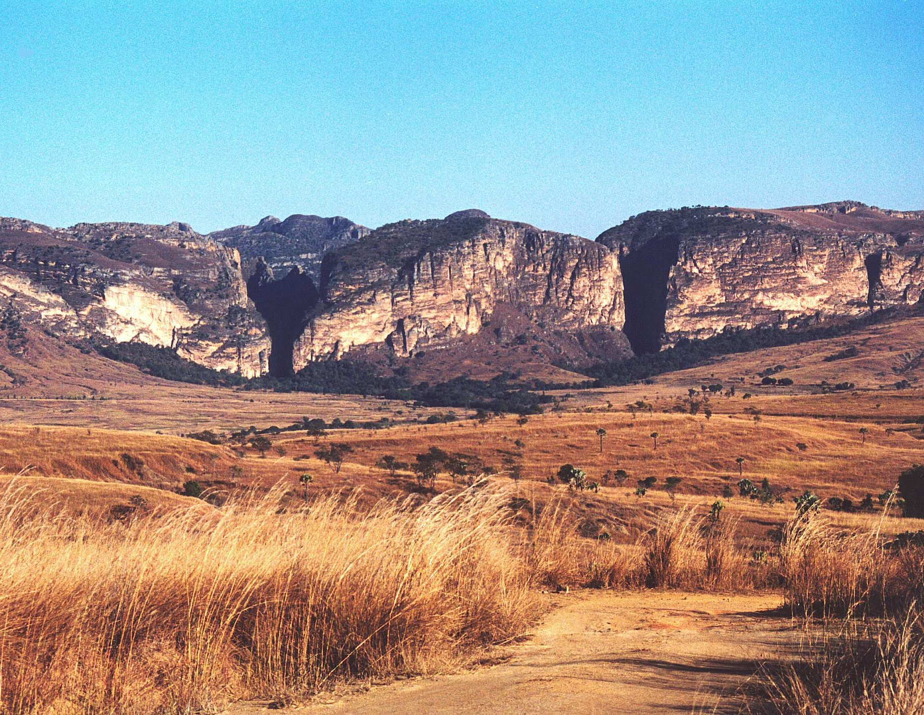
Draw the Landforms
Inselberg isolated steep-sided rock hill on a plain
Oasis
Grassland Plains
3 minutes
drawing time

Slide 30
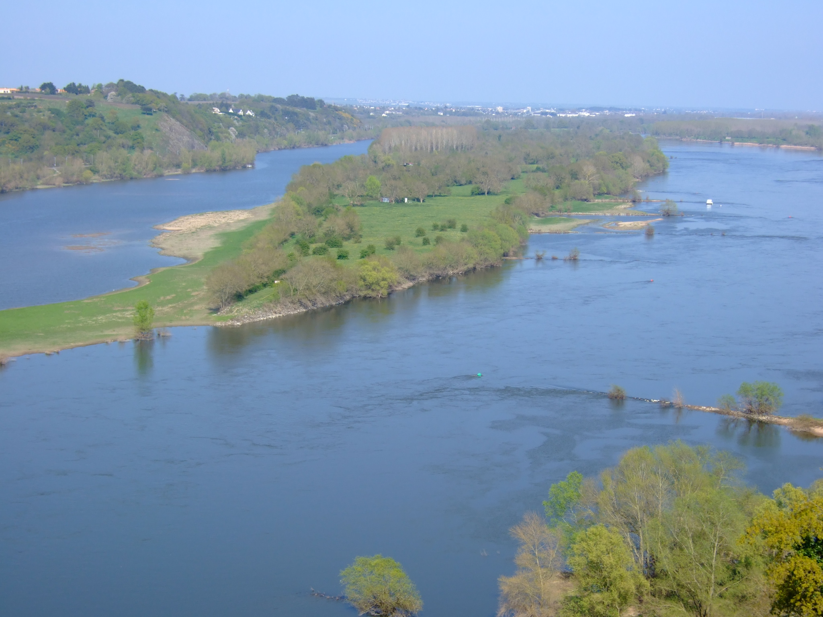
Riverine Landscapes
Formed by the natural movement of a water system such as a river. Includes the ecosystems in and around the area of a river.
Gorges, waterfalls, rapids, flood plains, billabongs, delta and river beds.

Slide 31
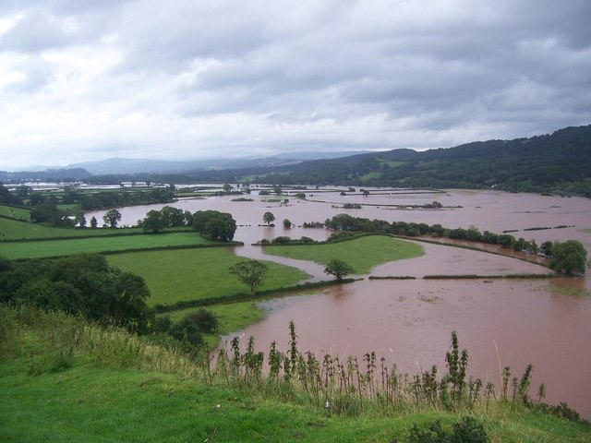
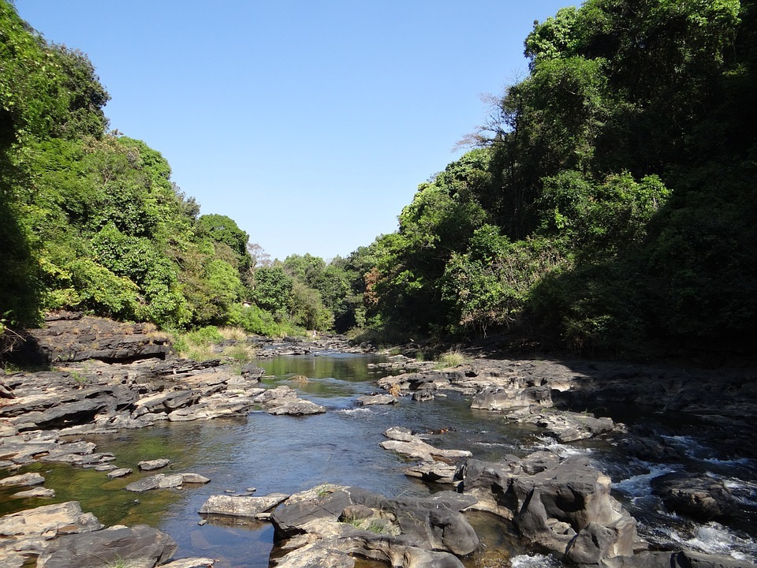
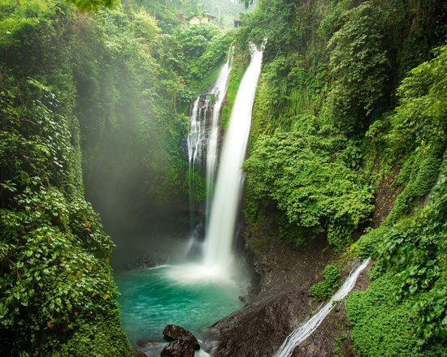
Flood plain
River bed
Waterfall
3 minutes
drawing time

Slide 32
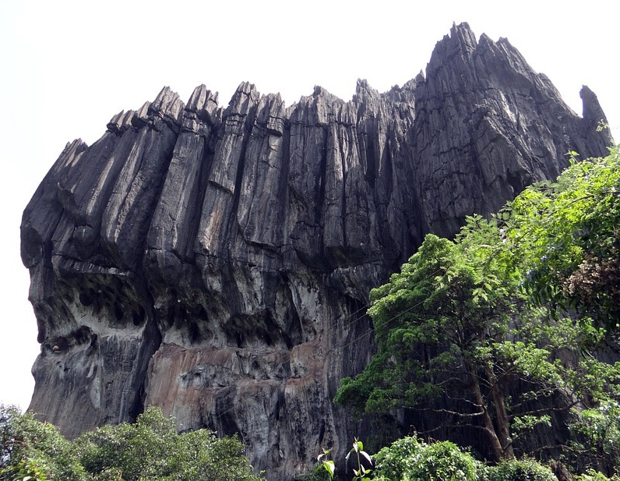
Karst Landscapes
A karst landscape is formed when easily dissolvable bedrock (the rock below the surface of the land, such as limestone) is worn away by slightly acidic water, from an underground source or a source on the Earth’s surface.
Common landforms include caves, sinkholes, stalagmites, stalactites
https://www.youtube.com/watch?v=lec7kHTOBAs
Notes:
https://www.youtube.com/watch?v=6uKhC8NeK9g extra Jewel Cave Augusta

Slide 33
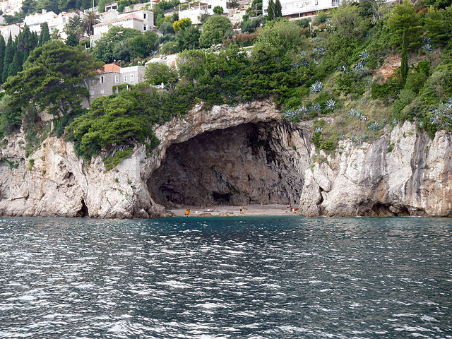
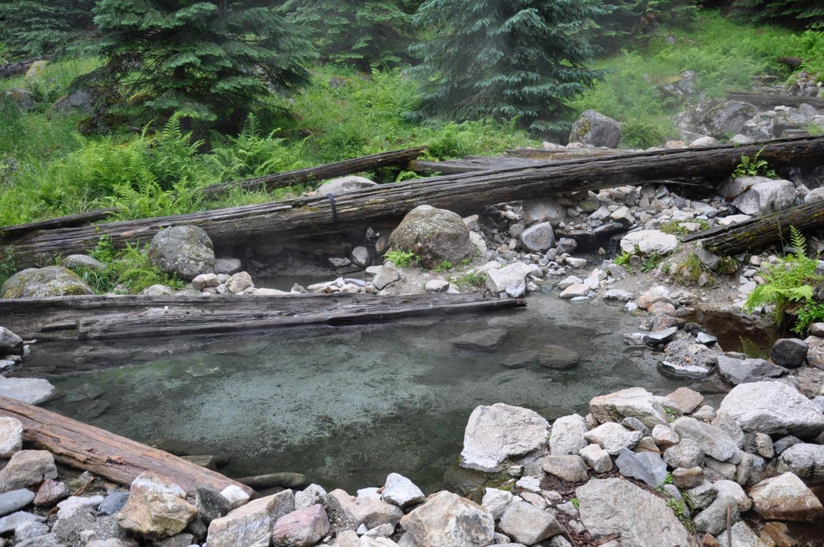
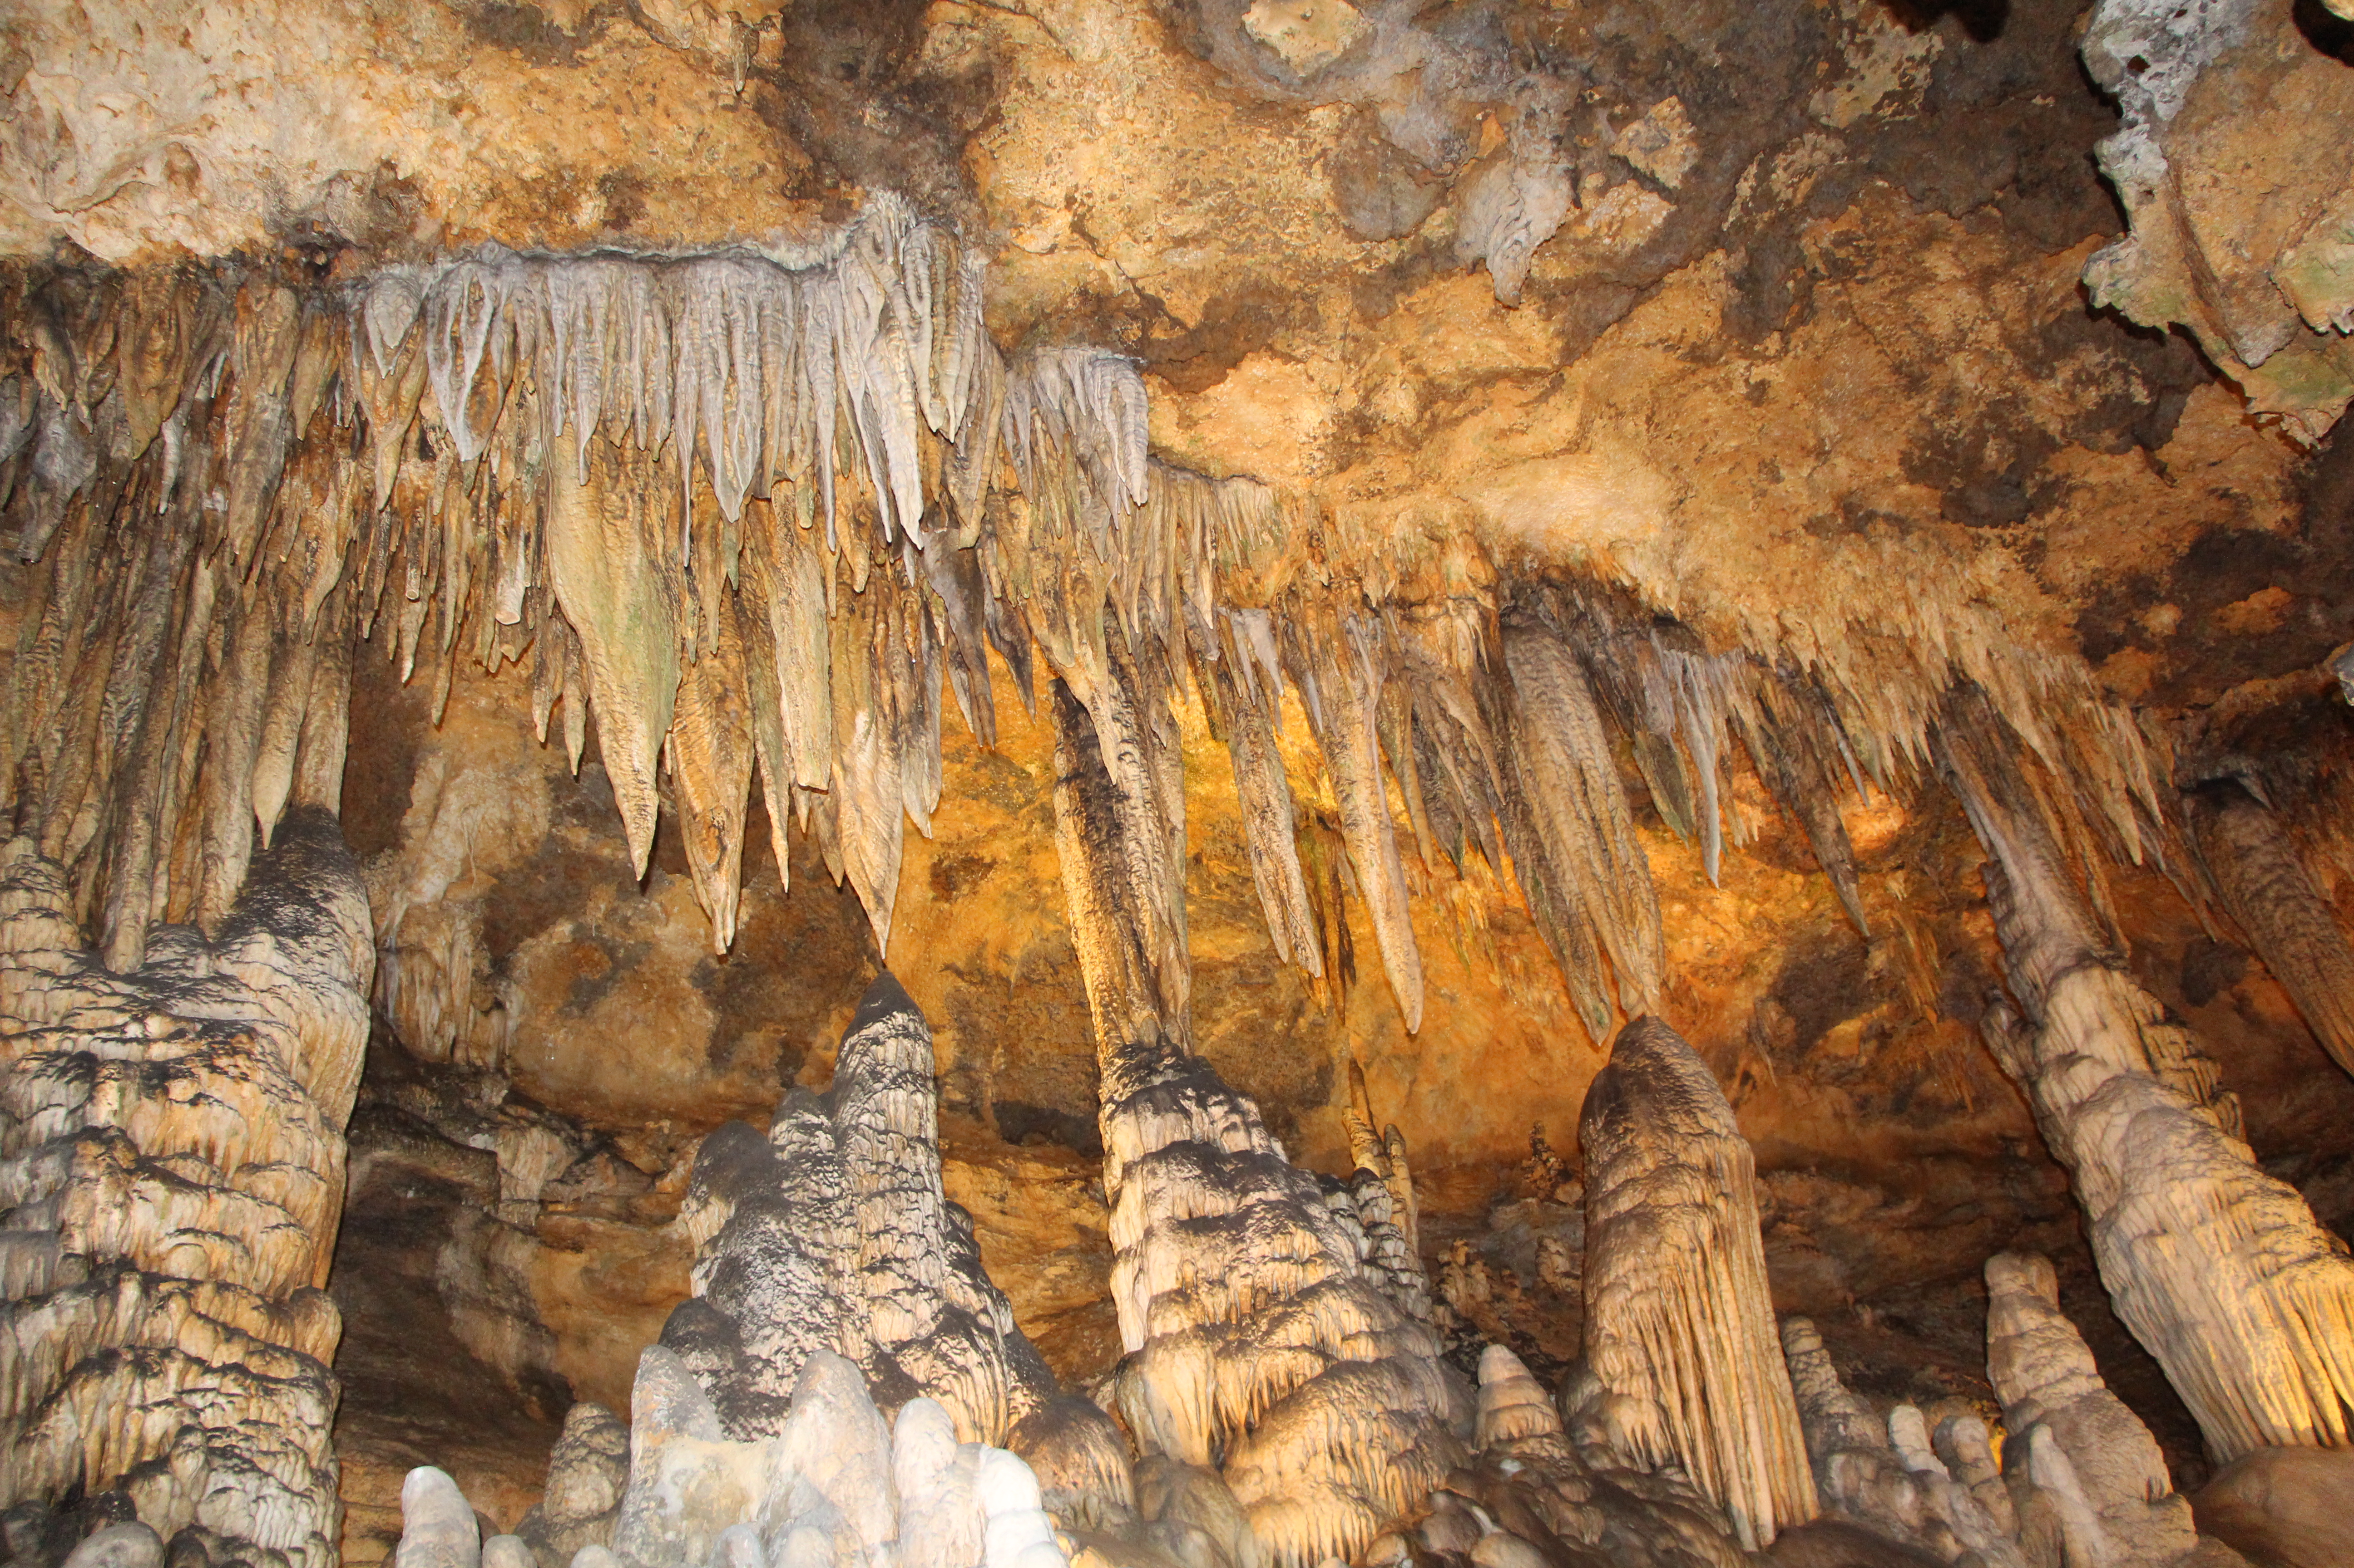
Draw the Landforms
Spring
Cave
Stalactite
3 minutes
drawing time

